Slide 1



Customer Analysis Presentation
Customer-Centered Market Insights
CUSTOMER CHURN FORECASTING
Presented By:
INDIRA DEVI.S

Slide 2

PROBLEM STATEMENT :
Develop a Customer Churn Forecasting system that analyzes customer data to identify customers at high risk of leaving a product or service. The system will use data preprocessing, exploratory analysis, feature engineering, and machine learning models to predict churn and provide actionable insights that help businesses improve customer retention and reduce customer loss.

Slide 3


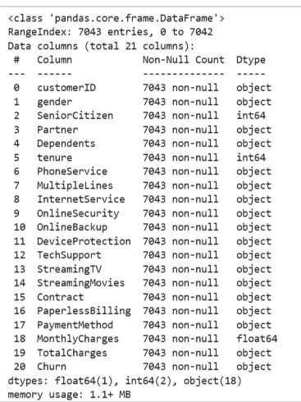

DATASET -OVERVIEW
• Dataset: IBM Telco Customer Churn
• Target variable: Churn
• Customer, service, contract and billing information are included.
• Key variables include tenure, MonthlyCharges, TotalCharges, Contract, TechSupport and Dependents.
• Churn is converted into a binary target: No = 0, Yes = 1.
3

Slide 4
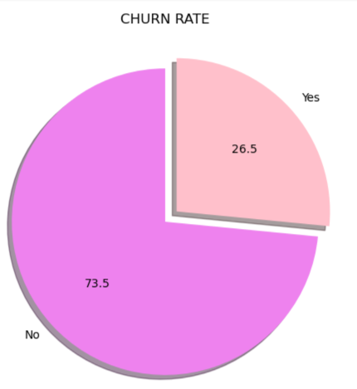


Defining Ideal Customer Segments
“The chart shows that 26.5% of customers have churned, while 73.5% have remained with the service. This indicates a high churn rate, suggesting that the business needs to focus on customer retention and identify the key factors driving customer loss.
Target Customer Profile

Slide 5

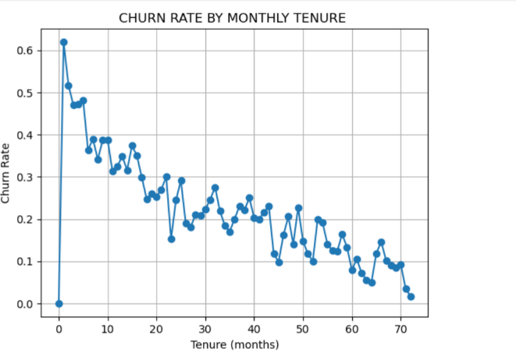
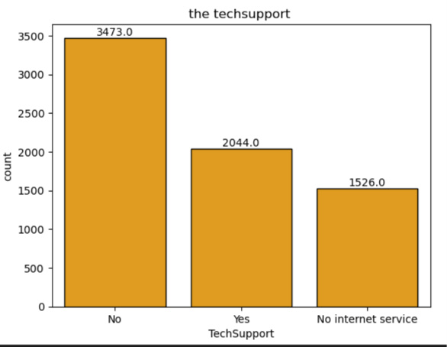

Customer Needs Analysis
Identifying Needs and Pain Points
The chart shows an inverse relationship between tenure and churn rate. Customers with lower tenure have a relatively higher churn rate, while the churn rate generally decreases as tenure increases. This indicates that newer customers may be more vulnerable to churn, making tenure an important feature for churn prediction.

Slide 6

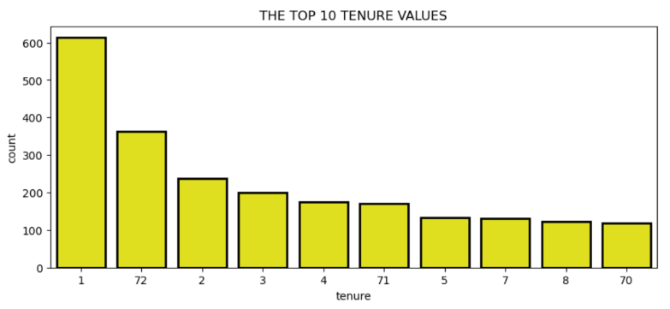
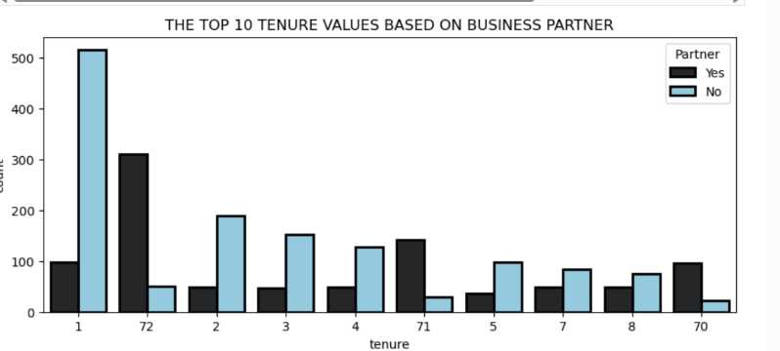
The chart shows that 1 month is the most frequently occurring tenure, followed by 72 months. This means a large number of customers are either very new customers or have stayed with the company for a long period.
The first chart shows that 1 month is the most frequent tenure value, followed by 72 months. The second chart breaks these tenure values down by partner status. At 72 months, customers with a partner are more numerous than customers without a partner, whereas at 1 month, customers without a partner are more numerous. This shows how partner status varies across different tenure groups.

Slide 7
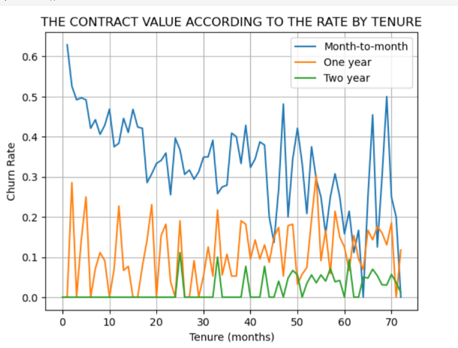
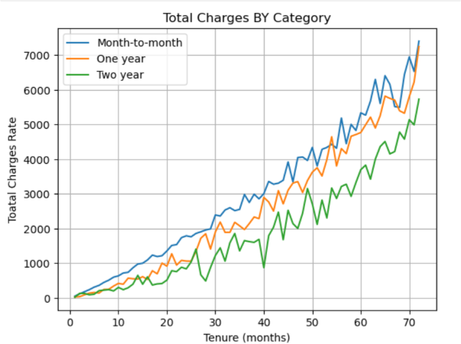
What Drives Customer Choices
Total charges generally increase with customer tenure because customers accumulate charges over a longer period. The chart also shows differences in total charges across contract categories.
Customers on month-to-month contracts show higher churn rates compared with customers on one-year and two-year contracts. Customers with longer tenure also generally show lower churn rates, suggesting that newer customers and month-to-month customers are more associated with churn.

Slide 8
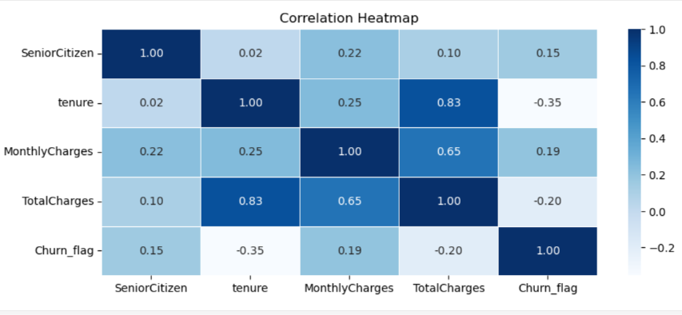
The heatmap shows that tenure has a moderate negative correlation with churn, with a correlation coefficient of -0.35, indicating that churn generally decreases as tenure increases. Monthly charges have a weak positive correlation with churn at 0.19, while total charges have a weak negative correlation of -0.20. I also observed a strong positive correlation of 0.83 between tenure and total charges, which indicates that total charges generally increase as customer tenure increases.

Slide 9
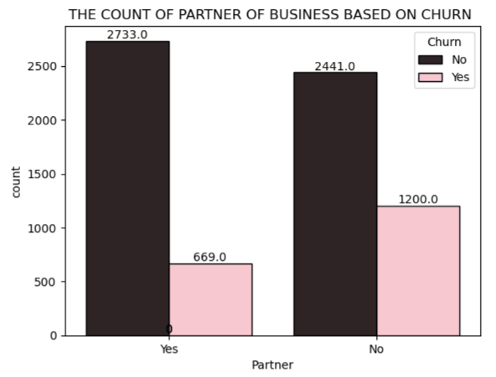
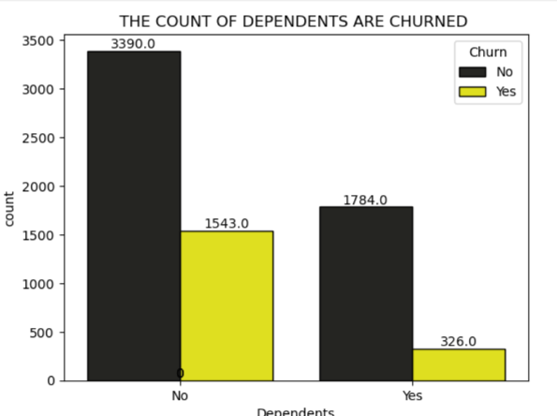
The analysis shows that customers with partners have a lower churn rate compared with customers without partners. Similarly, customers with dependents have a lower churn rate than customers without dependents. This suggests that partner and dependent status are associated with customer churn in the dataset.

Slide 10
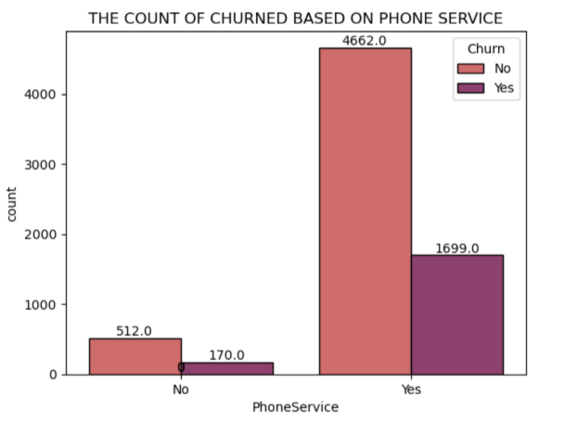
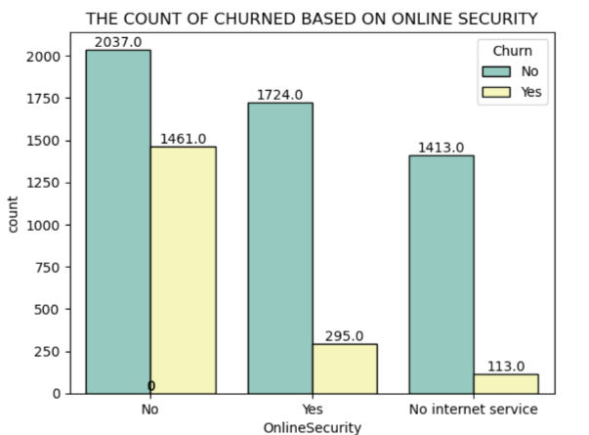
Customers with phone service have a churn rate of approximately 26.7%, while customers without phone service have a churn rate of approximately 24.9%. Therefore, the churn rates are quite similar, with phone-service customers showing a slightly higher churn rate.
Customers without online security have the highest churn rate at approximately 41.8%. Customers with online security have a much lower churn rate of approximately 14.6%, while customers with no internet service have the lowest churn rate at approximately 7.4%

Slide 11
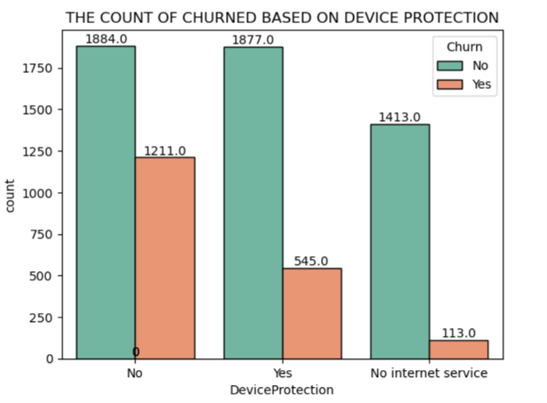
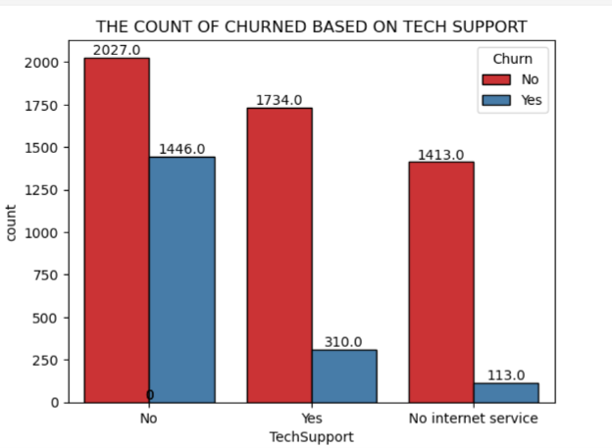
Customers without device protection have a churn rate of approximately 39.6%, compared with 22.5% among customers who have device protection. Customers with no internet service have the lowest churn rate at around 7.4%.
Customers without tech support have a churn rate of approximately 41.6%, whereas customers with tech support have a much lower churn rate of approximately 15.2%. Customers with no internet service have the lowest churn rate at around 7.4%.

Slide 12
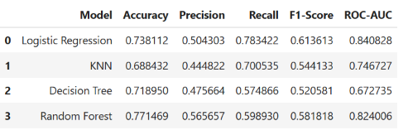
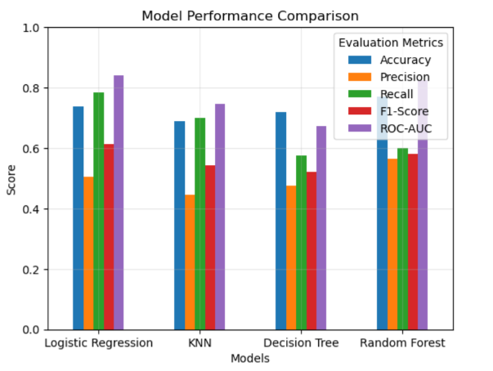
MODEL PERFROMANCE AND EVALUTION

Slide 13
EXECUTIVE SUMMARY
Critical Churn Risk: 31% of customers churn within the first 2 months
Tenure Impact: Strong inverse correlation between tenure and churn (r=0.83)
Business Partner Model: Customers with partnerships show 75% better retention
Service Dependencies: Tech support, device protection, and online security reduce churn
Revenue Opportunity: Month-to-month contracts generate 2x higher churn vs. annual plans

Slide 14

BUSINESS INSIGHTS :
Offer support packages or proactive assistance.
Contact high-risk customers before they churn.
Monitor whether providing support improves rete.
Offer device protection as on optimal package
Provide targeted offers to customers without device protection
Combine device protection with retention campaigns
Mostly New Customer are likely to Churn So To avoid it we could bring plan so we could avoid churn of new customers

Slide 15


Thank you so much

